Slide 1

Poverty Traps and Infectious Disease Risk Reduction
Chris Barrett
Dyson School/Brooks School
CIDERFest
September 2, 2026

Slide 2
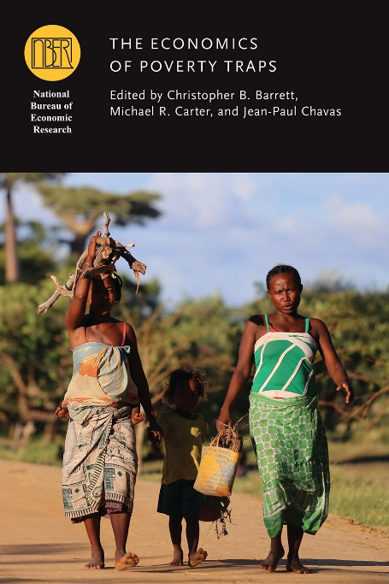
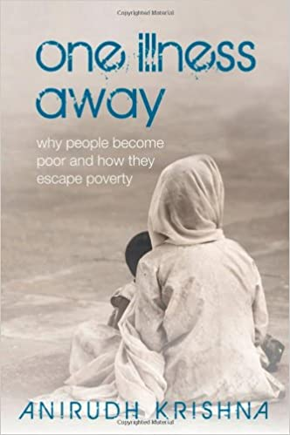


Why deep, persistent, prevalent poverty?
The poorest places are defined not only by the depth and prevalence of poverty but equally by poverty’s persistence. A poverty trap, wherein even optimal behaviors don’t lead to expected escape?
An emergent view of poverty traps emphasizes uninsured risk exposure as a key cause.
The possibility of risk-based poverty traps puts a premium on risk reduction (and risk transfer) tools.

Slide 3
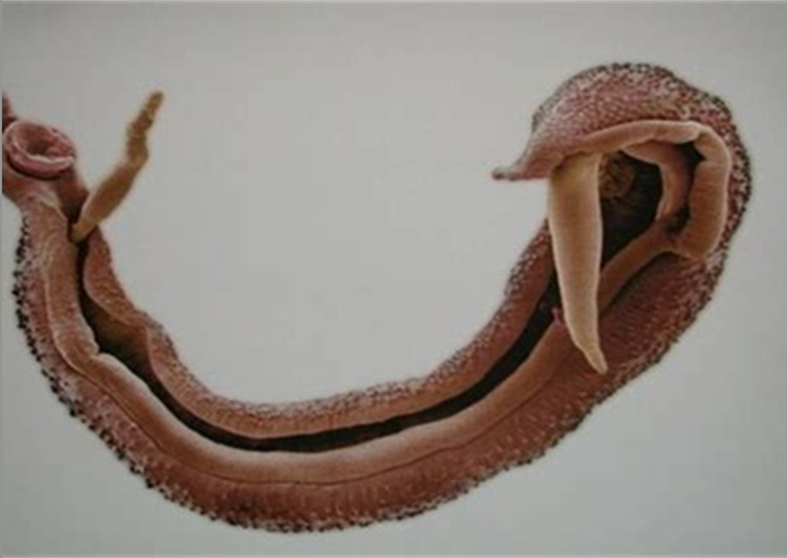
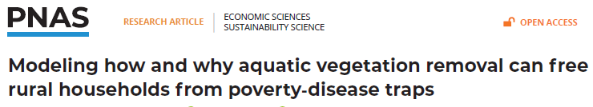
Reducing infectious disease risk in Senegal
Schistosomiasis/bilharzia affects >240mn globally (>800 mn at risk) in poor areas. Suppresses immunoresponse.
Especially harmful for children/women.
Usual response: MDA (praziquantel) but high reinfection rates. Need to tackle the environmental reservoir of the disease.
Poverty-disease trap: Impedes child cognitive/physical dev’t via anemia, morbidity. Disrupts work/school attendance, lowers incomes, increasing reliance on contaminated water sources.

Slide 4
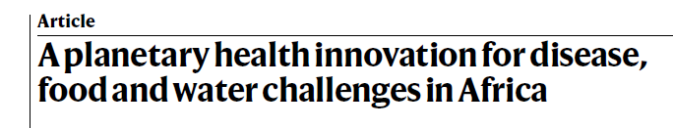
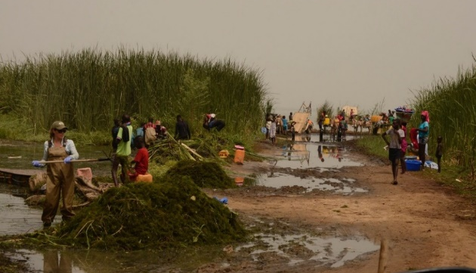
Reducing infectious disease risk in Senegal
Candidate remedies:
1) Clear water access points of snails’ preferred habitat: submerged weed Ceratophyllum demersum and use as compost (B/C: 2.8 - 7.1) or livestock feed. Sharply reduced infections, boosted ag productivity.
Photo credit: Jason Rohr
Can we get villagers to do this? Does it have the same impacts as the researcher-managed trials? We launched a 104 village RCT in 2024 to find out. Endline upcoming winter 2026-27.

Slide 5
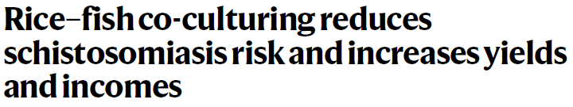
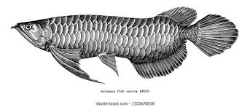
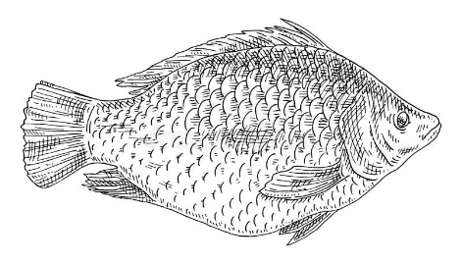
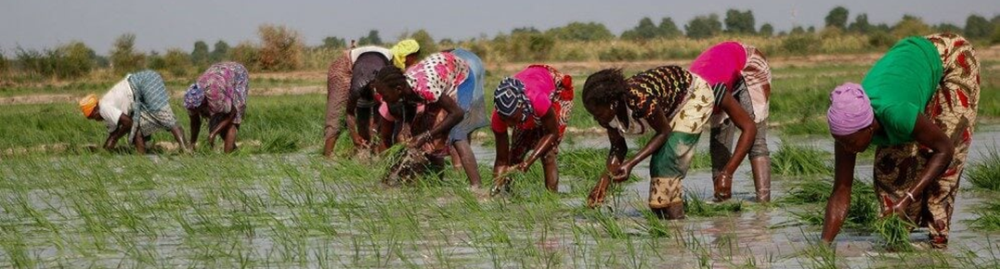
Reducing infectious disease risk in Senegal
Candidate remedies:
(2) Introduce fish to irrigated rice fields to compete with (tilapia) or prey on (African bonytongue) snails, boost crop productivity. Small-scale RCT wrapping now.
What gains in rice productivity? Impacts on household livelihoods, food security, or mental/physical health? Prevalence of infected snails?
Photo credit: Emily Selland

Slide 6
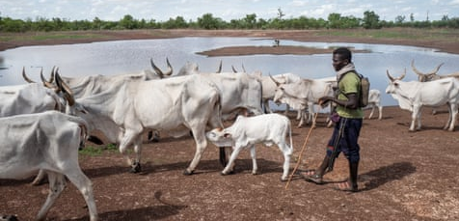
Reducing infectious disease risk in Senegal
Candidate remedies:
(3) Vaccinate livestock against schistosomiasis bovis. Reduce spatial transmission/hybridization of disease. Boost livestock productivity.
Designing 2027 trial now with (Brazilian) vaccine developer.
Possibly incorporate methane emissions testing to see if there might be potential to generate carbon credits to pay for vaccines for Senegalese herders.
Reach out if any of this interests you – esp. if you speak French (or Wolof or Pulaar!)
Photo credit: Andy Hall/The Observer

